Slide 1
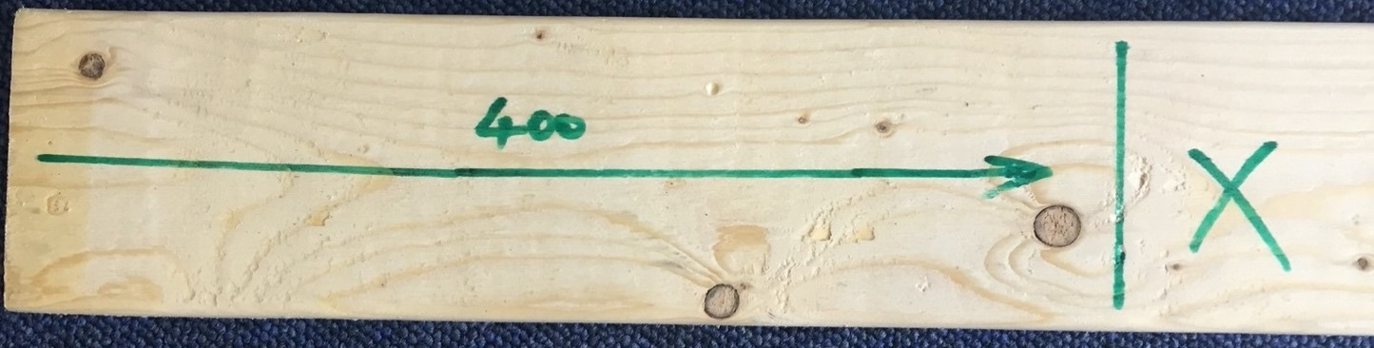
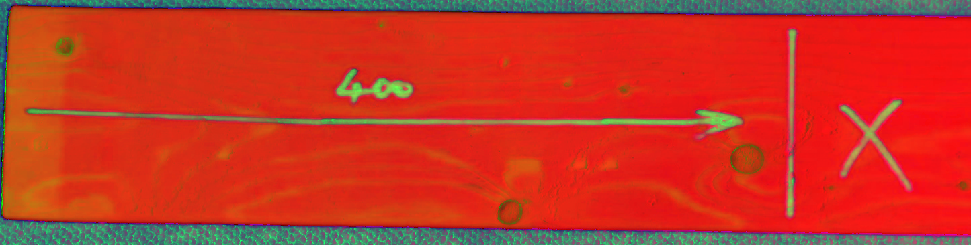
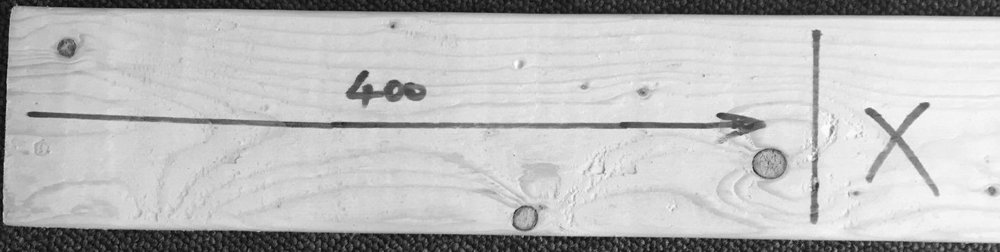
Handwriting
Recognition
Steps:
HSV image
img=cv2.imread('carpenter.jpg')
hsv = cv2.cvtColor(img, cv2.COLOR_BGR2HSV)

Slide 2
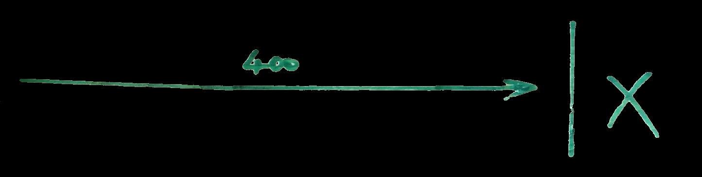

1.a Median blur
# define range of blue color in HSV
lower_green = np.array([55,50,0])
upper_green = np.array([90,255,255])
# Threshold the HSV image to get only blue colors
mask = cv2.inRange(hsv, lower_green, upper_green)
# Bitwise-AND mask and original image
res = cv2.bitwise_and(img,img, mask= mask)
2. Edge detection with Canny
median_blur = cv2.medianBlur(res,9)
edges = cv2.Canny(median_blur,100,170)

Slide 3
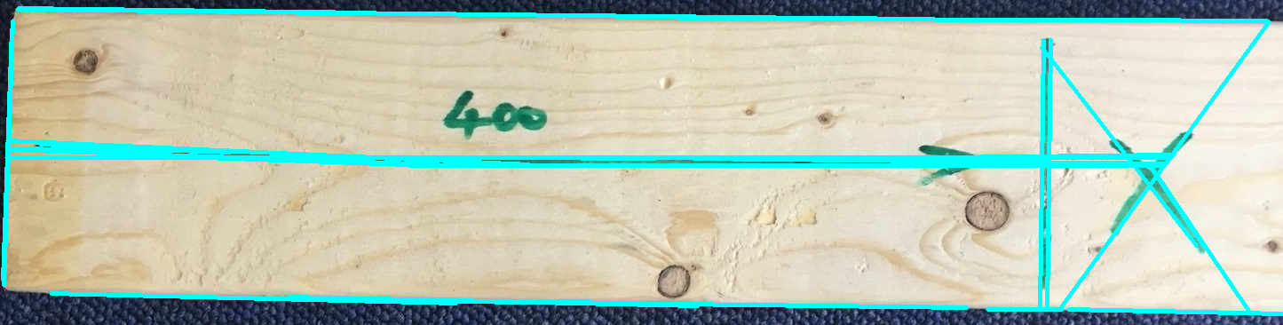
3. Hough transform for direction detection
# Detect points that form a line
lines = cv2.HoughLinesP(edges, 2, np.pi/270, 100, minLineLength=10, maxLineGap=250)
# Draw lines on the image
for line in lines:
x1, y1, x2, y2 = line[0]
cv2.line(img, (x1, y1), (x2, y2), (255, 0, 0), 3)
# Show result
cv2_imshow(img)

Slide 4
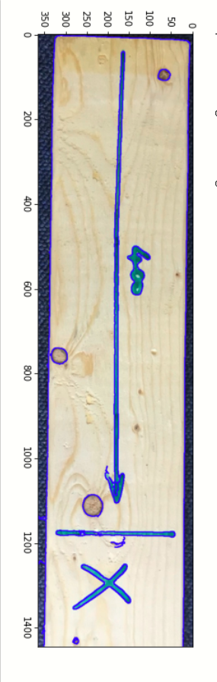
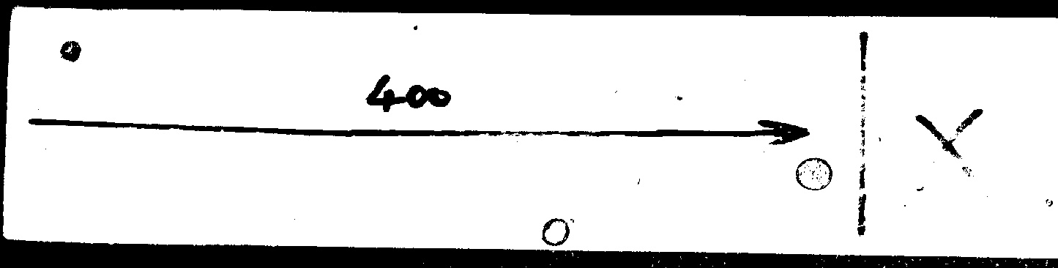
Preprocessing

Slide 5
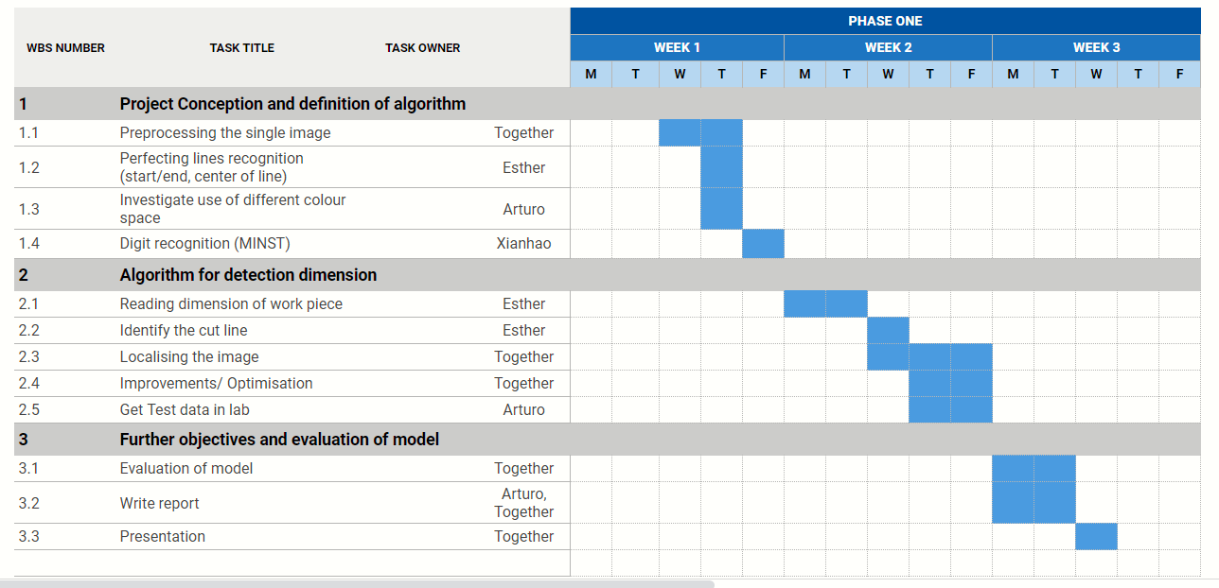
Project plan

